Slide 1

Schema Management and Evolution
Davide Mauri
damauri@microsoft.com
Microsoft
Level: Intermediate

Slide 2

Davide Mauri
Joined Azure SQL group on mid 2019
SQL Server / Azure Data MVP for 12 Years
Worked in consulting services for 20 years
Still a developer at heart!
Now Azure SQL PM
Focus on Azure SQL & Developers
Very active in the Community, Conference Speaker
Website: http://davidemauri.it/
DevBlogs: https://devblogs.microsoft.com/azure-sql/
Twitter: @mauridb

Slide 3
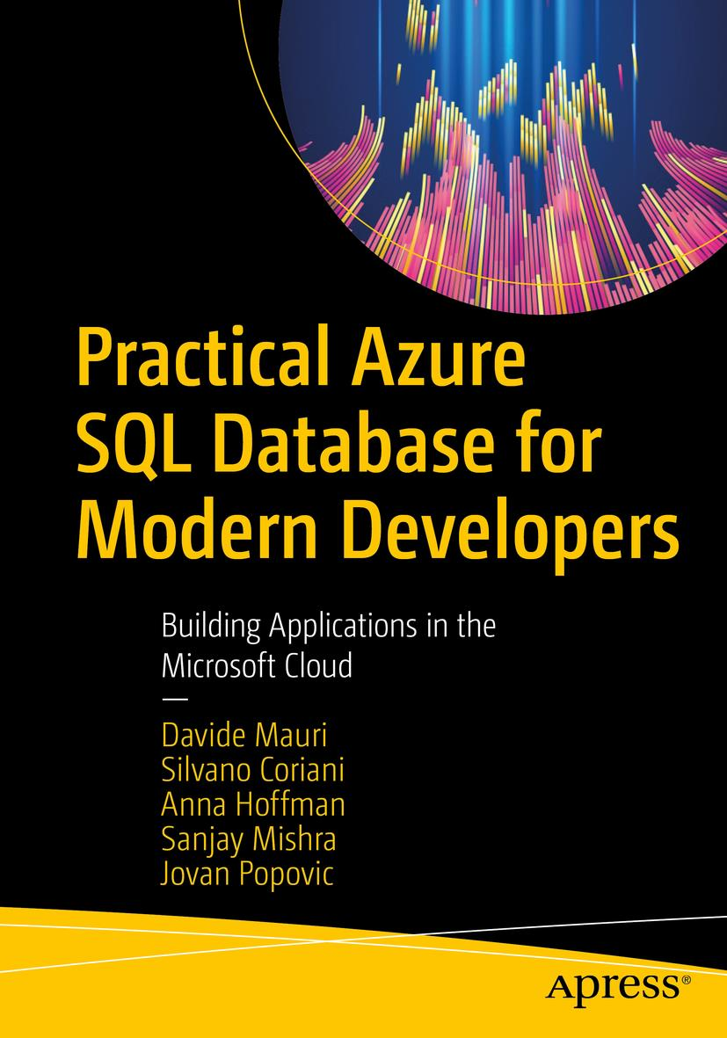
A Database book for Developers
A developer-focused book, to help you leverage all the relational and post-relational features that Azure SQL has, to easily create fast, scalable and secure applications
Lots of samples and discussions taking into account different languages:
Python
.NET
Java
And more!

Slide 4

Session Survey
Your feedback is very important to us
Please take a moment to complete the session survey found in the mobile app
Use the QR code or search for “Converge360 Events” in your app store
Find this session on the Agenda tab
Click “Session Evaluation”
Thank you!

Slide 5
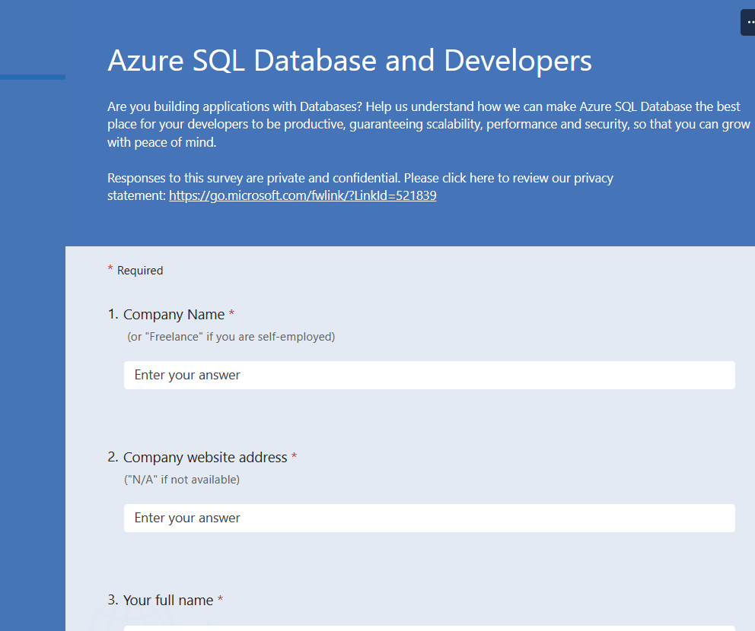
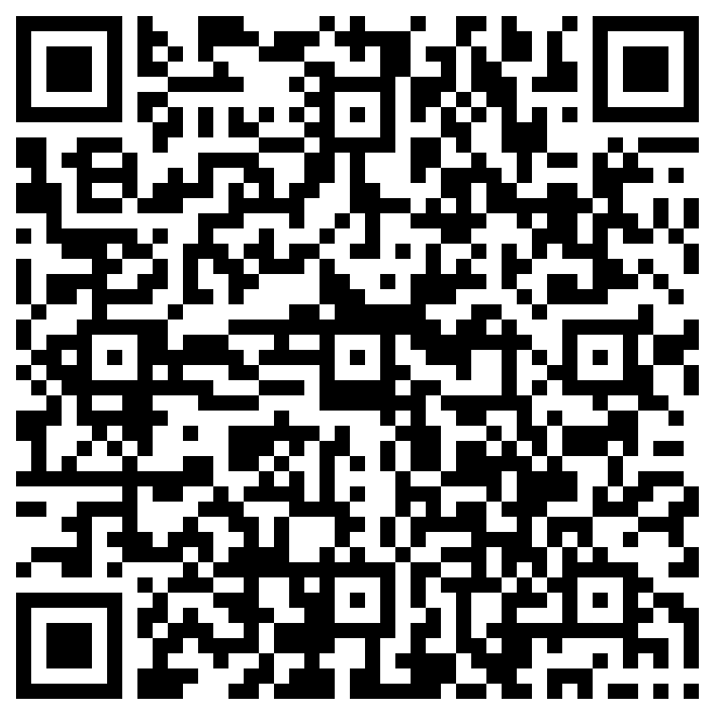
Tell us what you want from Azure SQL
https://aka.ms/datadevlist

Slide 6

Modern Development What’s That?
Supports multiple clients
Provides an API for accessing data and services
Data is available in a generic, consumable format
Can scale-out & Support automated deployment
Is Resilient and Fault-Tolerant
Is Designed to allow constant evolution and improvements
Secure from ground-up

Slide 7
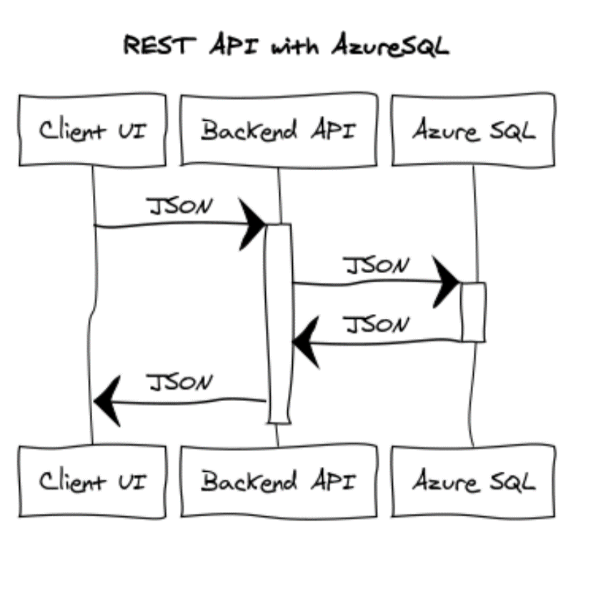
Modern Development - What’s That?
Supports multiple clients
Provides an API for accessing data and services
Data is available in a generic, consumable format
Can scale-out & Support automated deployment
Is Resilient and Fault-Tolerant
Is Designed to allow constant evolution and improvements
Secure from ground-up

Slide 8
Schema-less. Schema-what?
There is no such thing as a “Schemaless” structure. (See: “Contradiction”) https://www.martinfowler.com/articles/schemaless/
The discussion is “where do I prefer to manage my schema”?
In the application (Classes -> POCO/POJO/gRPC/GraphQL Schema)
In the database (Tables)
I don’t really care about the schema (my code will handle nicely any unknown property/field)

Slide 9

Dynamic Schema A discussion that really matter!
The real question is: “How to make it easy to change/evolve my schema, so that I don’t necessarily have to:
Update Data or Database and/or
Rebuild, Compile, Deploy my app
As both are potentially dangerous and user-impacting operations”?

Slide 10

Flexibility. Is that all?
Performances
Aggregations
Security
Integration (with other models)?
Scalability
Data Integrity
Manageability

Slide 11

JSON and Azure SQL to the rescue
Azure SQL natively support JSON
JSON is a great option to stabilize stored procedure, query or function signature
Send back and forth an array of objects to Azure SQL
OPENJSON + FOR JSON
JSON can also be used to store data into Azure SQL
Can be indexed too
Integrates with all other Azure SQL features
Graph Models, Columnstore Indexes, Ledger tables, In-Memory Tables, Encryption, etc…

Slide 12
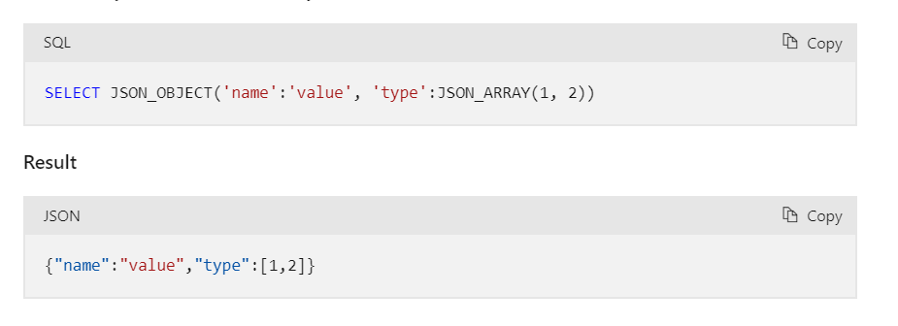
JSON and Azure SQL to the rescue
Since SQL Server 2022, and supported in Azure SQL already

Slide 13
Pick the best option for you
Classic Table, use JSON as transport
Hybrid Table: classic columns for well-known properties, “extension” JSON column for anything you don’t know
Document Table: Just JSON

Slide 14
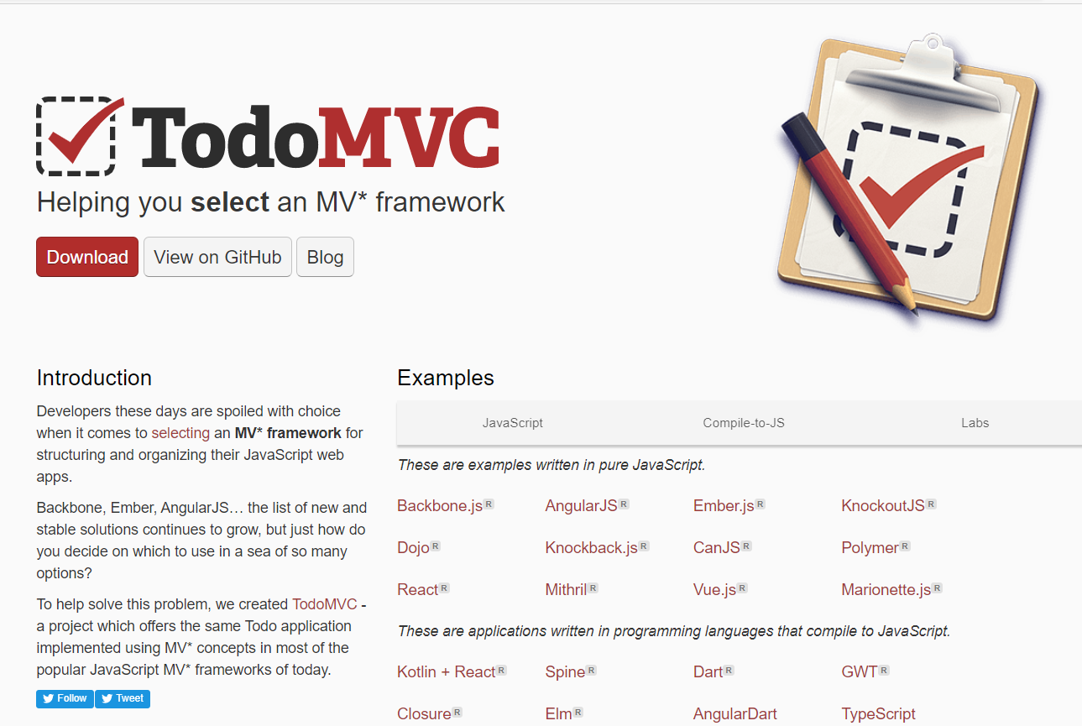
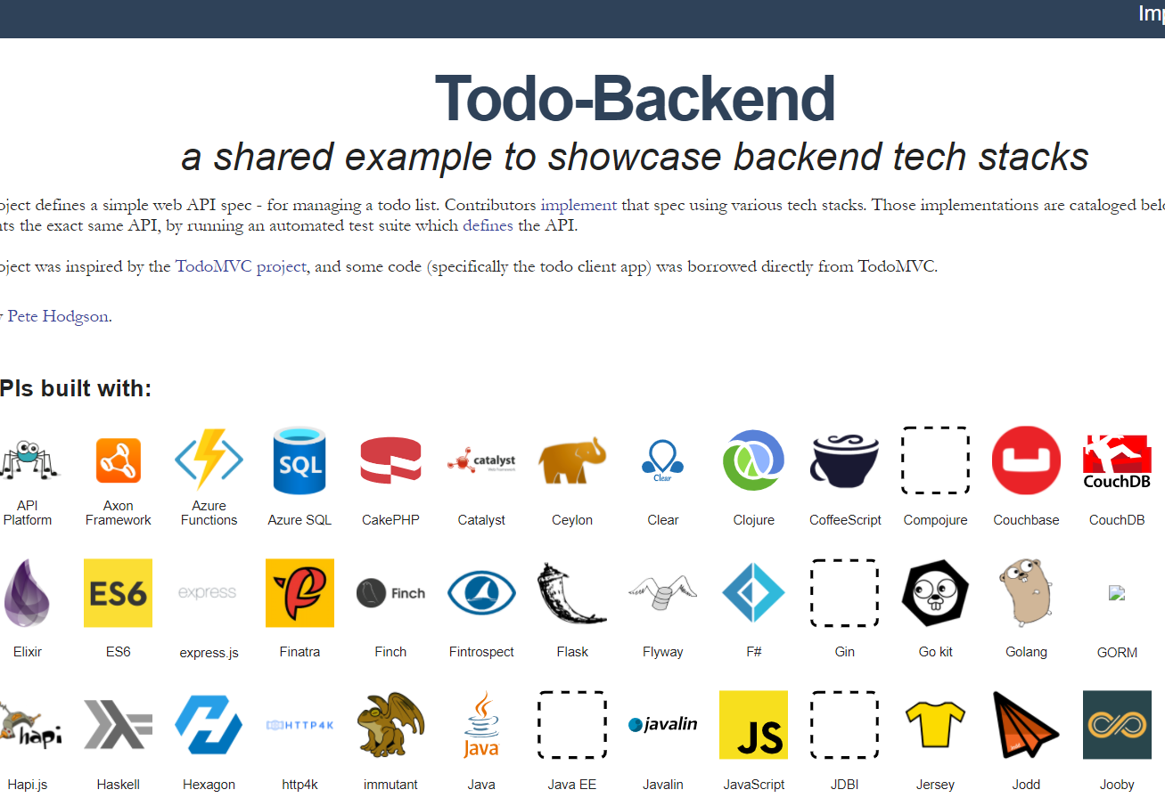
An interesting playground
https://todomvc.com/
http://www.todobackend.com/

Slide 15
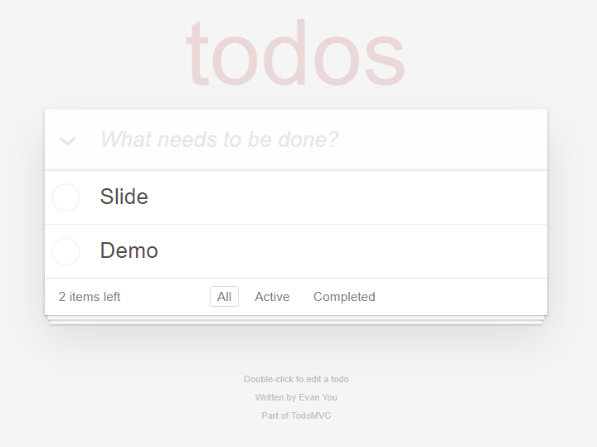

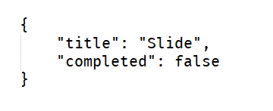

Data Flow

Slide 16
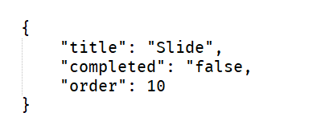

What happens if schema needs to change?

Slide 17

Demo

Slide 18
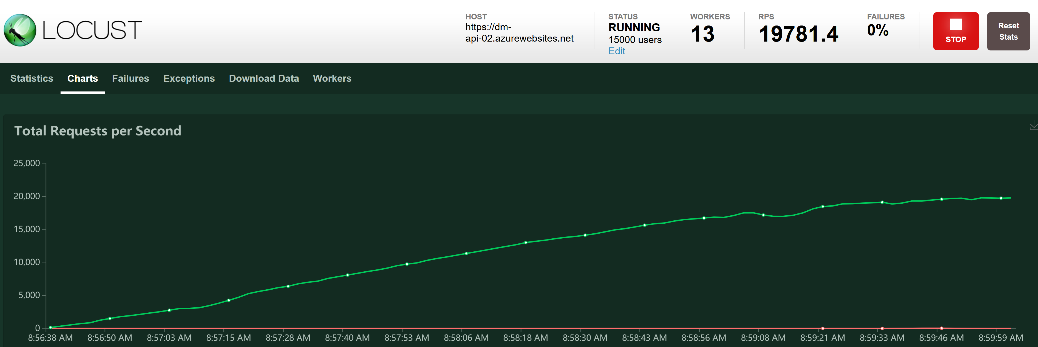
What about performances?
JSON give you flexibility.
Flexibility has some overhead (in fact gRPC is on the rise…)
But…

Slide 19
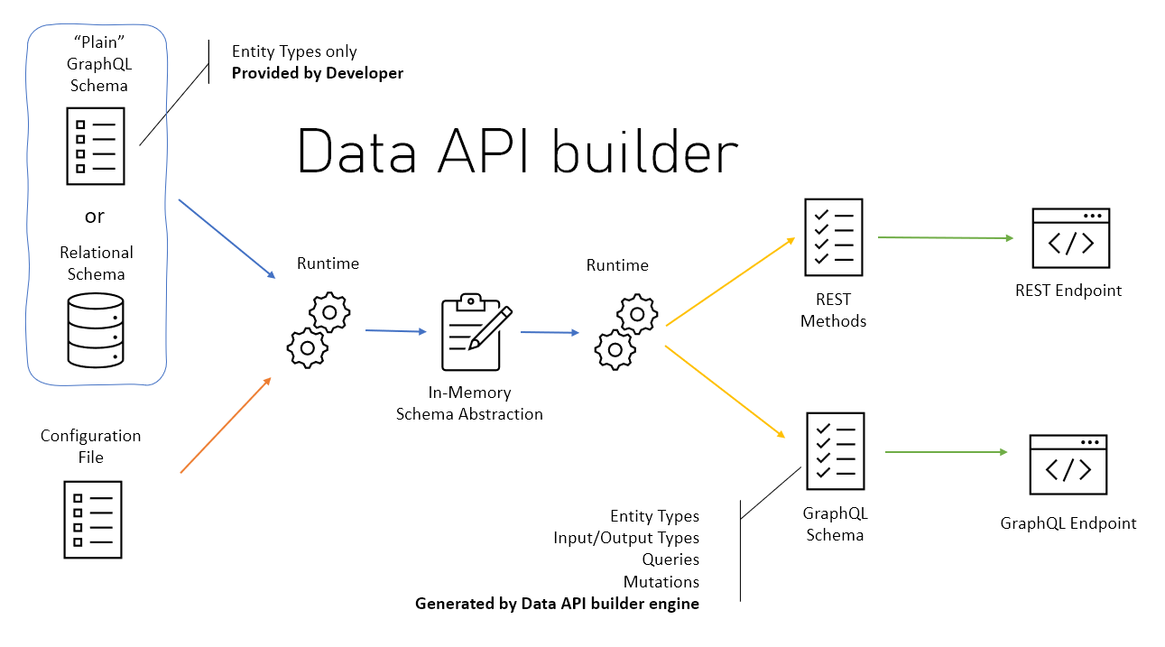
Data API builder
https://aka.ms/dab

Slide 20
Tell us what you want from Azure SQL
https://aka.ms/datadevlist

Slide 21
Session Survey
Your feedback is very important to us
Please take a moment to complete the session survey found in the mobile app
Use the QR code or search for “Converge360 Events” in your app store
Find this session on the Agenda tab
Click “Session Evaluation”
Thank you!

Slide 22

Questions?

Slide 23
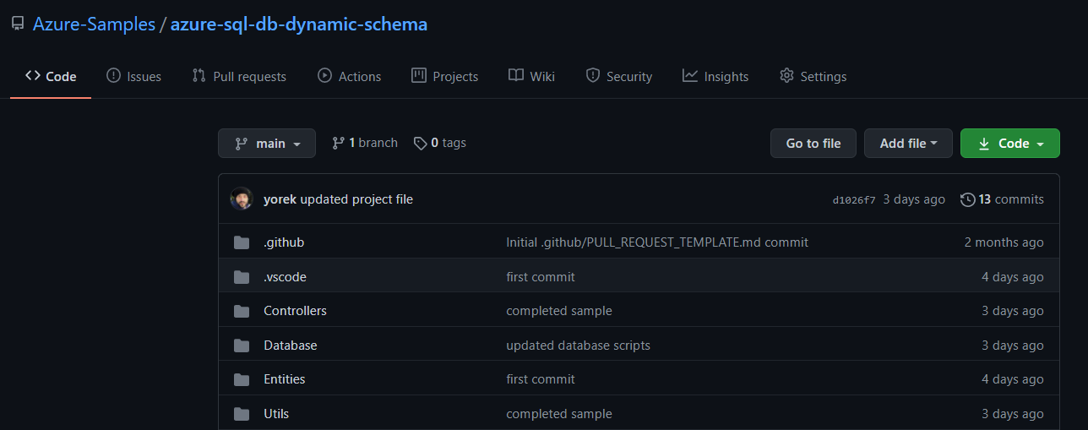
Resources
10K RPS REST API with Azure SQL, Dapper and JSON
https://github.com/Azure-Samples/azure-sql-db-dynamic-schema
https://github.com/Azure-Samples/azure-sql-db-dynamic-schema-ef

Slide 24
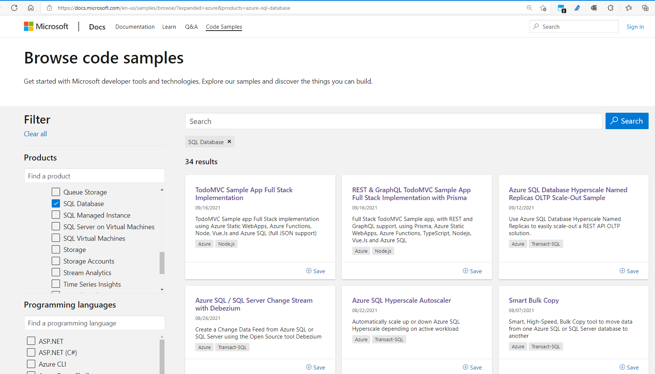
And for even more goodness…
https://learn.microsoft.com/en-us/samples/browse/

Slide 25

Thanks!

